Slide 1
zhang yaojun
WEEK 4 ASSIGNMENT

Slide 2
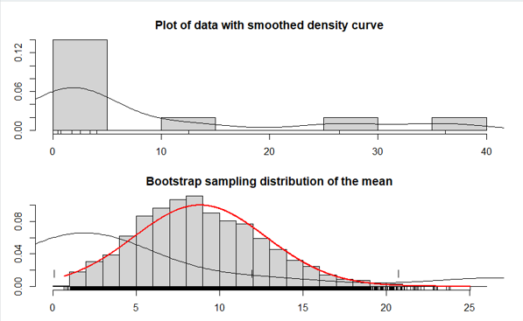
> bs.one.samp.dist<-function(dat,N=1e4){ + n<-length(dat); + sam<-matrix(sample(dat,size=N*n,replace = TRUE),ncol=N); + sam.mean<-colMeans(sam); + old.par<-par(no.readonly=TRUE) + par(mfrow=c(2,1),mar=c(3,2,2,1),oma=c(1,1,1,1)) + hist(dat,freq=FALSE,breaks=6 + ,main="Plot of data with smoothed density curve") + points(density(dat),type="l") + rug(dat) + + hist(sam.mean,freq=FALSE,breaks=25 + ,main="Bootstrap sampling distribution of the mean" + ,xlab=paste("Data:n=",n + ,",mean=",signif(mean(dat),digits=5) + ,",se=",signif(sd(dat) /sqrt(n)),digits=5)) + points(density(dat),type="l") + x<-seq(min(sam.mean),max(sam.mean),length=1000) + points(x,dnorm(x,mean=mean(dat),sd=sd(dat)/sqrt(n)) + ,type="l",lwd=2,col="red") + rug(sam.mean) + par(old.par) + rug(dat) + } > x<-rgamma(10,shape=.5,scale=20) > bs.one.samp.dist(x)

Slide 3
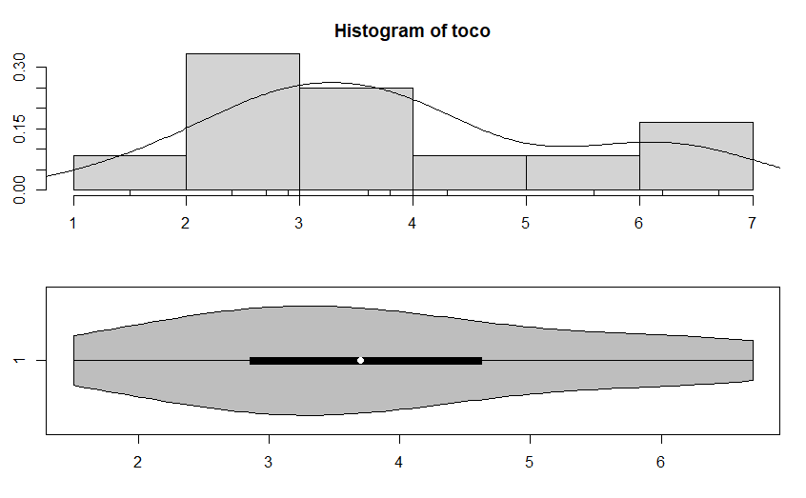
age<-c(54,42,51,54,49,56,33,58,54,64,49)
par(mfrow=c(2,1))
hist(age,freq=FALSE,breaks=6)
points(density(age),type="l")
rug(age)
library(vioplot)
vioplot(age,horizontal=TRUE,col="gray")

Slide 4
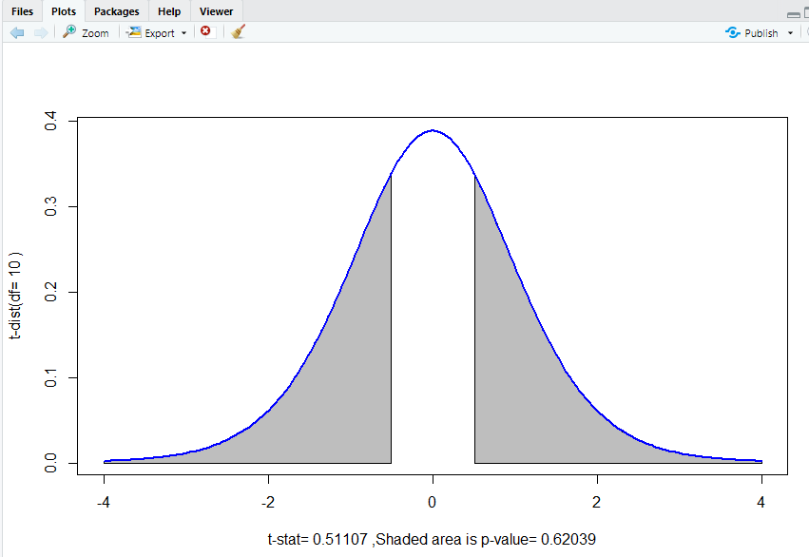
x.pval.l<-seq(lim.lower,-abs(t.summary$statistic),length=200)
y.pval.l<-dt(x.pval.l,df=t.summary$parameter)
polygon(c(lim.lower,x.pval.l,-abs(t.summary$statistic))
,c(0,y.pval.l,0),col="gray")
}
if((t.summary$alternative=="greater")
|(t.summary$alternative=="two.sided")){
x.pval.u<-seq(abs(t.summary$statistic),lim.upper,length=200)
y.pval.u<-dt(x.pval.u,df=t.summary$parameter)
polygon(c(abs(t.summary$statistic),x.pval.u,lim.upper)
,c(0,y.pval.u,0),col="gray")
}
points(x.curve,y.curve,type="l",lwd=2,col="blue")
}
t.dist.pval(t.summary)
stem(age,scale=2)
qt(1-0.05/2,df=length(age)-1)
?t.test
t.summary<-t.test(age,mu=50)
t.summary
summary(age)
bs.one.samp.dist(age)
t.dist.pval<-function(t.summary){
par(mfrow=c(1,1))
lim.extreme<-max(4,abs(t.summary$statistic)+0.5)
lim.lower<--lim.extreme;
lim.upper<- lim.extreme;
x.curve<-seq(lim.lower,lim.upper,length=200)
y.curve<-dt(x.curve,df=t.summary$parameter)
plot(x.curve,y.curve,type="n"
,ylab=paste("t-dist(df=",signif(t.summary$parameter,3),")")
,xlab=paste("t-stat=",signif(t.summary$statistic,5)
,",Shaded area is p-value=",signif(t.summary$p.value,5)))
if((t.summary$alternative=="less")
|(t.summary$alternative=="two.sided")){

Slide 5
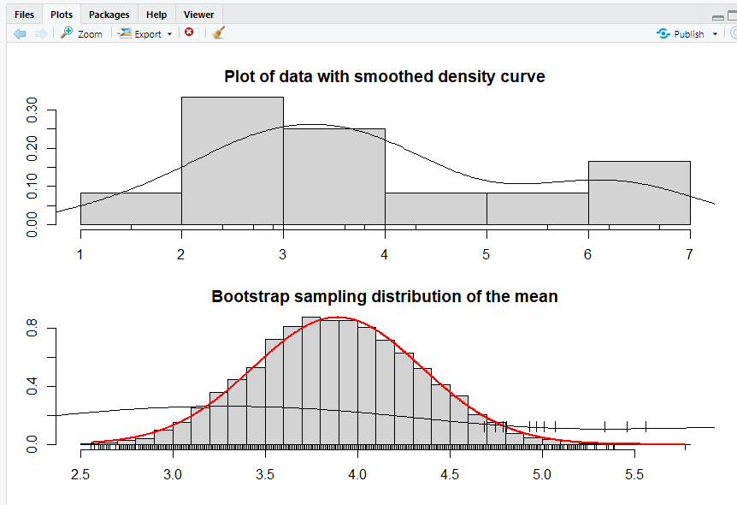
names(t.summary)
t.summary$statistic
t.summary$parameter
t.summary$p.value
t.summary$conf.int
t.summary$estimate
t.summary$null.value
t.summary$alternative
t.summary$method
t.summary$data.name
toco<-c(5.6,2.7,6.2,2.9,1.5,4.0,4.3,3.0,3.6,2.4,6.7,3.8)
par(mfrow=c(2,1))
hist(toco,freq=FALSE,breaks=6)
points(density(toco),type="l")
rug(toco)
library(vioplot)
vioplot(toco,horizontal=TRUE,col="gray")
stem(toco,scale=2)
qt(1-0.05/2,df=length(toco)-1)
t.summary<-t.test(toco,mu=0.54)
t.summary
summary(toco)
t.dist.pval(t.summary)
bs.one.samp.dist(toco)

